Slide 1
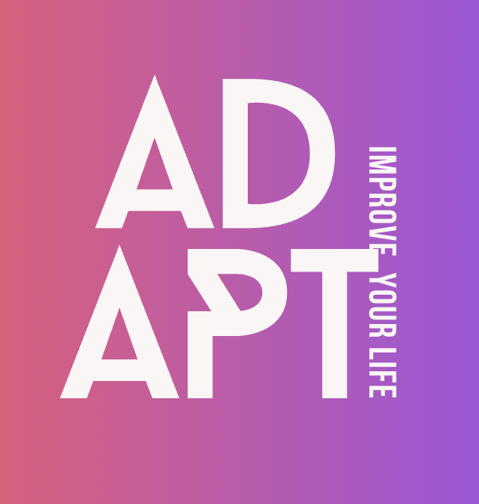
ADAPT:
Aiding Dietician and Personal Trainer
Emily Liang, Curtis Chen, Yu-Yuan Chang, Adriana Pinon, Bill Tran

Slide 2


What does ADAPT do?
With ADAPT you can get tailored recipes and workouts based on your specific nutritional and fitness goals with the clicks of a few buttons!!
Notes:
are you tired of having to type into google and then the first results aren’t even actual results, they’re sponsored?!

Slide 3

TT
TT = ?
NO! TT = Technologies used + Targeted Audience!
React and Firebase (sorry Google we actually like you)
ADAPT is meant for everyone!

Slide 4

Why??
ADAPT was motivated by the need to provide convenient and personalized health and fitness guidance for all.
The motivation behind creating ADAPT stemmed from the recognition of the challenges and barriers that individuals face when trying to improve their health and fitness. We understood that going to the gym for the first time or making significant dietary changes can be overwhelming and require extensive planning and research.
Notes:
motivation: increase of AI technology and virtual personal assistants (Siri, Alexa, etc)

Slide 5

3 Basic Features
Display Dynamic Data:
Show different recipes and workouts retrieved from the server
Show user’s current information
Upload data from the client to the backend:
User can type in and change their personal data
Meaningfully search through server side data:
User can search for recipes
User can search for workouts
Both are customized searches that are distinct features

Slide 6

Distinct Features
Manual Login and Google Login
both of which will save user data
used in customization search
Customized Search
Food (intersection)
Workout (union)
Customize Food Options by BMI
Notes:
(make sure information is private and save. Everytime login information still there)
List all the workout target
Sometime we want food has both features

Slide 7
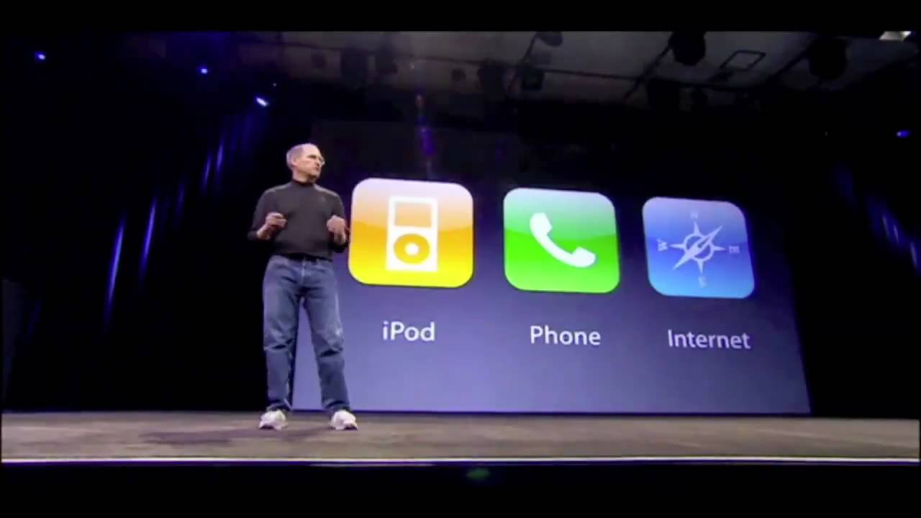
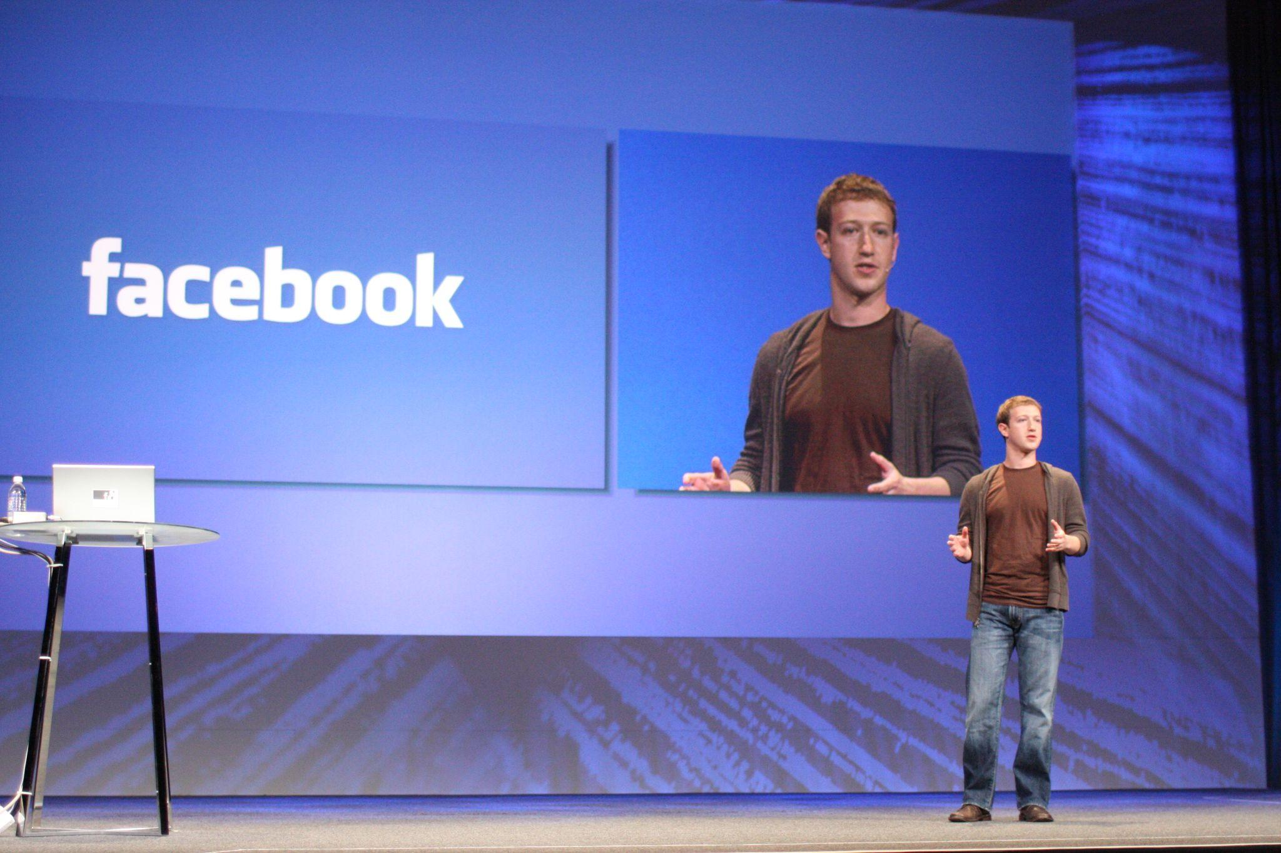

Live demo time!
Notes:
web app should already be open and ready to go

Slide 8
Thanks for watching!

